Slide 1


SPOTIFY
Song Popularity Analysis
Data Science
Digital Fair Skill 35.0

Slide 2
01. About Me
02. About Spotify
03. Information
04. Tools
05. Pre-processing Data
06. Exploratory Data Analysis (EDA)
07. Pre-processing Data for Machine Learning
08. Data Modeling for Machine Learning
09. Training Model
10. Final Visualization
11. Conclusion
Table
of Contents

Slide 3

I am an undergraduate Information Systems student with a deep interest in Data Science. Experienced in Data Science competitions, I have developed AI and data analysis-based solutions for real-world problems, including in the Digital Talent Scholarship 2024 program. I have skills in data exploration, statistical analysis, and data visualization to support better decision making.
About
Me

Slide 4

Spotify is a music, podcast, and digital video streaming service that allows users to listen to millions of songs and audio content from various artists around the world. Launched in 2008 by Daniel Ek and Martin Lorentzon in Sweden, Spotify offers a freemium model, where users can enjoy a free service with ads or subscribe to Spotify Premium for an ad-free experience, higher audio quality, and additional features such as offline mode.
About
Spotify

Slide 5
Artist: Name of the Artist.
Song: Name of the Track.
Duration_ms: Duration of the track in milliseconds.
Explicit: The lyrics or content of a song or music video contain one or more elements that may be considered offensive or unsuitable for children.
Year: Release Year of the track.
Popularity: The higher the value, the more popular the song is.
Danceability: Describes how suitable a track is for dancing based on a combination of musical elements such as tempo, rhythm stability, beat strength, and overall regularity. A value of 0.0 is least danceable, and 1.0 is most danceable.
Energy: Measures the intensity and activity of a track from 0.0 to 1.0.
Key: The key the track is in. Integers map to pitches using standard Pitch Class notation. For example, 0 = C, 1 = C♯/D♭, 2 = D, and so on. If no key is detected, the value is -1.
Loudness: The overall loudness of a track in decibels (dB). Loudness values are averaged across the entire track and are useful for comparing relative loudness of tracks. Values typically range between -60 and 0 dB.
Mode: Indicates the modality (major or minor) of a track, the type of scale from which its melodic content is derived. Major is represented by 1 and minor is represented by 0.
Information

Slide 6
Speechiness: Detects the presence of spoken words in a track. The closer the value is to 1.0, the more exclusively speech-like the track. Values above 0.66 describe tracks that are likely entirely spoken words.
Acousticness: A confidence measure from 0.0 to 1.0 of whether the track is acoustic. A value of 1.0 indicates high confidence the track is acoustic.
Instrumentalness: Predicts whether a track contains no vocals. The closer the value is to 1.0, the more likely the track contains no vocal content. Values above 0.5 represent instrumental tracks, with higher confidence as the value approaches 1.0.
Liveness: Detects the presence of an audience in the recording. Higher liveness values indicate a greater probability that the track was performed live. A value above 0.8 strongly suggests the track was recorded live.
Valence: A measure from 0.0 to 1.0 describing the positivity conveyed by a track. Tracks with high valence sound more positive (e.g., happy, cheerful, euphoric), while tracks with low valence sound more negative (e.g., sad, depressed, angry).
Tempo: The overall estimated tempo of a track in beats per minute (BPM). Tempo refers to the speed or pace of a given piece and derives directly from the average beat duration.
Genre: The genre of the track.
Information

Slide 7








Tools

Slide 8
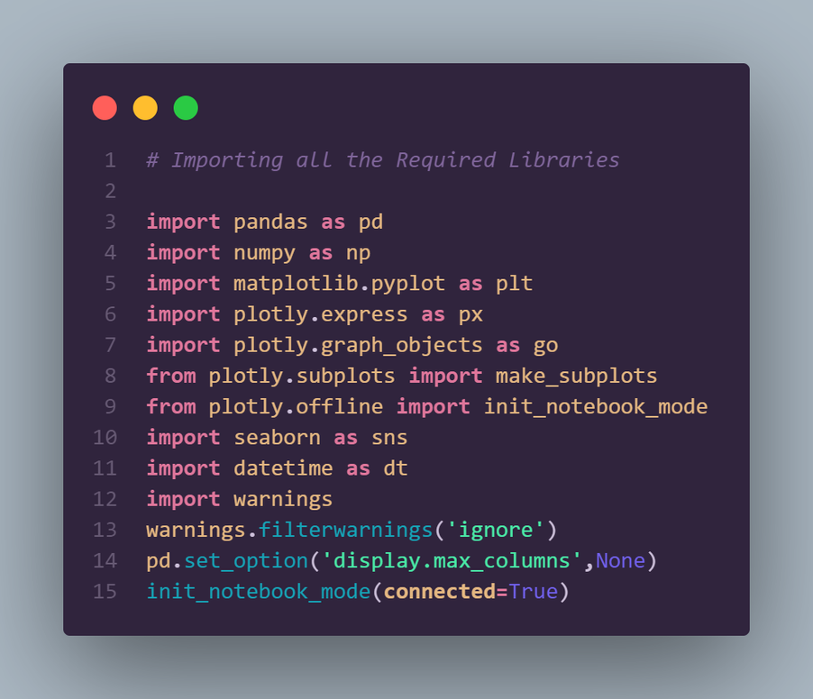
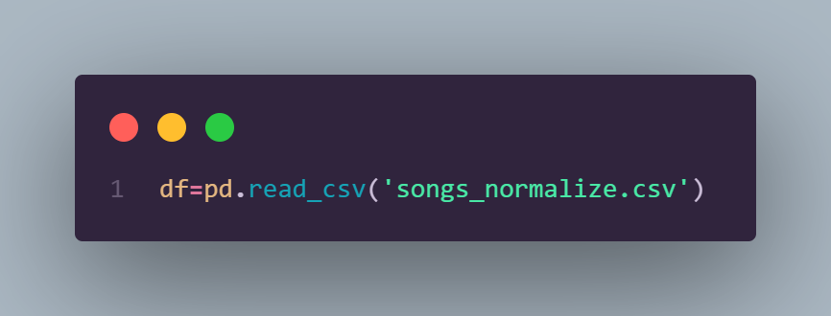
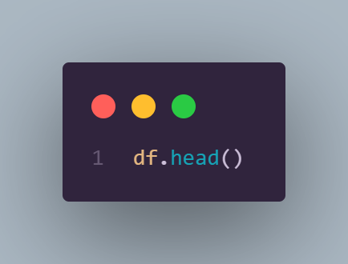
Pre-processing Data
Importing all the Required Libraries
Reading Files
Show the Top 5 Data

Slide 9
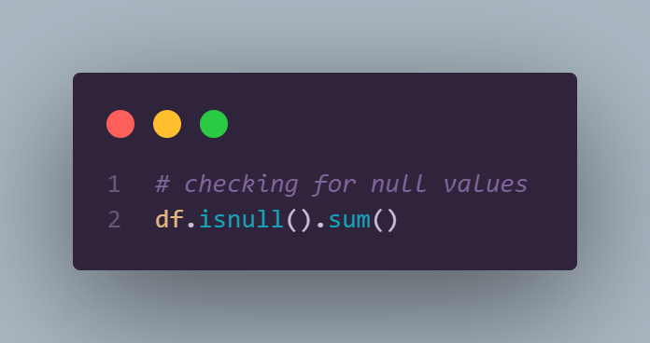
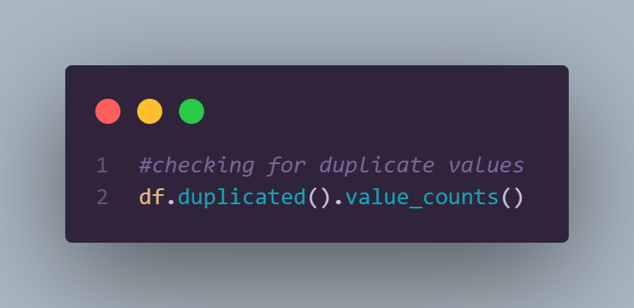

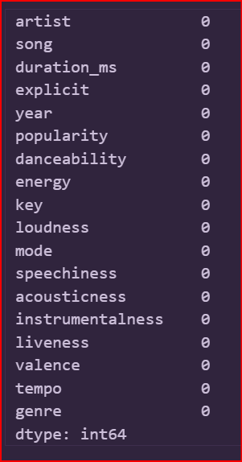
Exploratory Data Analysis
Checking for null values
Checking for duplicate

Slide 10
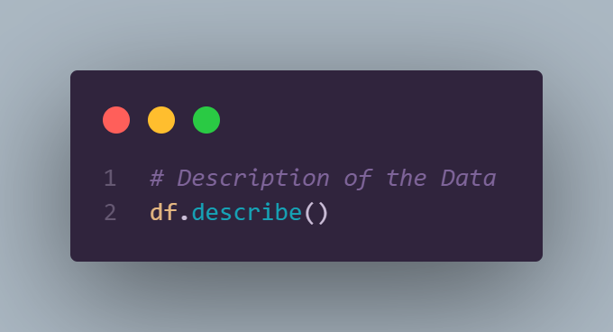
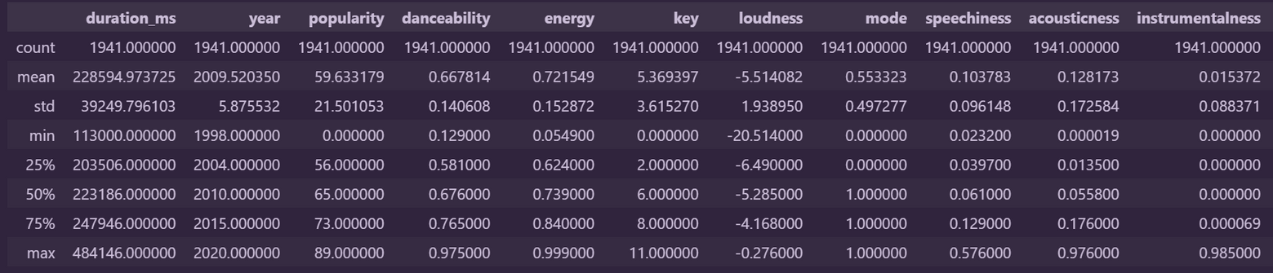
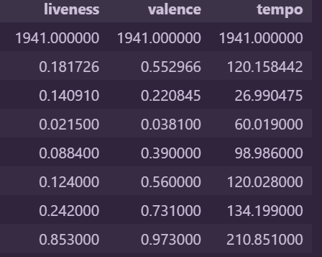
Exploratory Data Analysis
Description of the Data

Slide 11
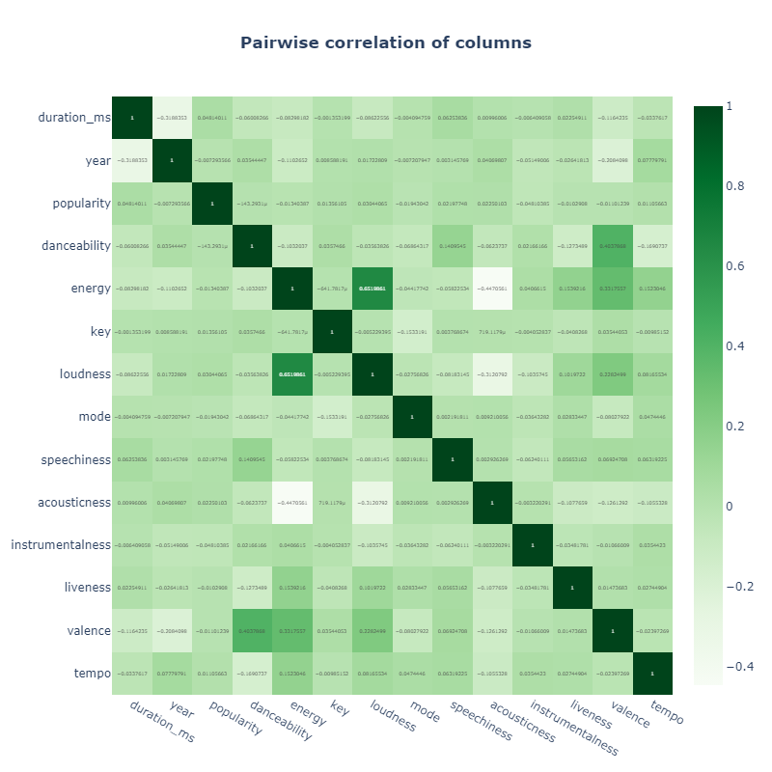
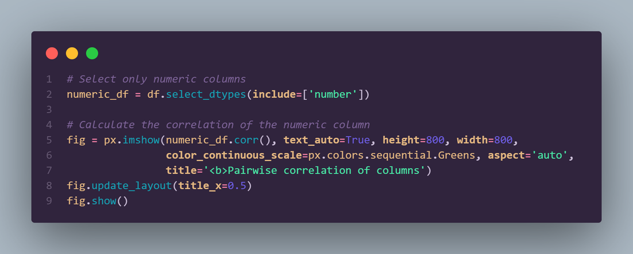
Exploratory Data Analysis
This heatmap shows pairwise correlations between columns in the dataset, including duration, year, popularity, and various audio features such as danceability, energy, and valence. Strong positive correlations are marked in dark green, while low or negative correlations are marked in light green. The highest correlation (1) indicates a perfectly positive relationship. This visualization helps understand the relationship between features in the dataset, which is useful for data analysis and feature selection in machine learning models.

Slide 12
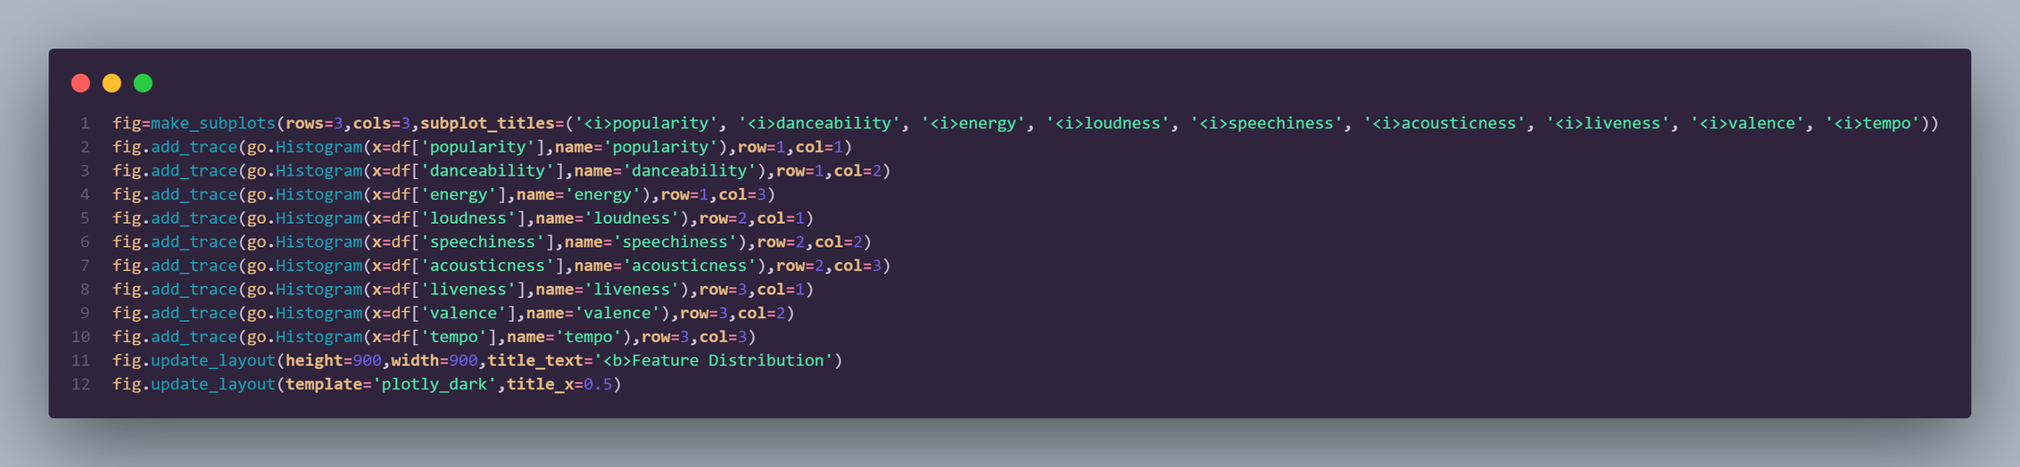
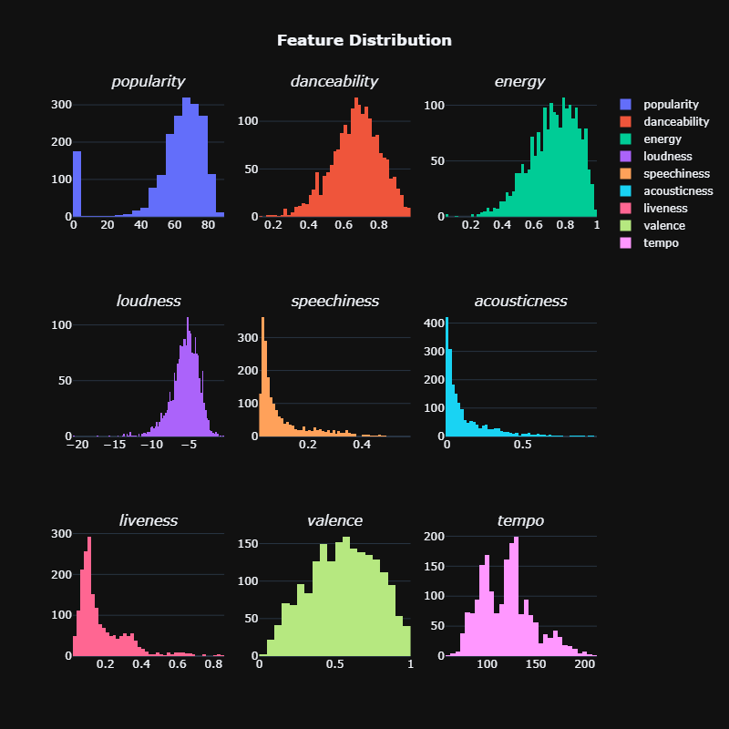
Exploratory Data Analysis
This visualization depicts the distribution of various musical features relevant in song analysis, such as popularity, danceability, energy, loudness, speechiness, acousticness, liveness, valence, and tempo. Based on the graphs presented.
Overall, this visualization reveals the trend of energetic, danceable, and modernly produced music, with characteristics that match the current preferences of the general market.

Slide 13
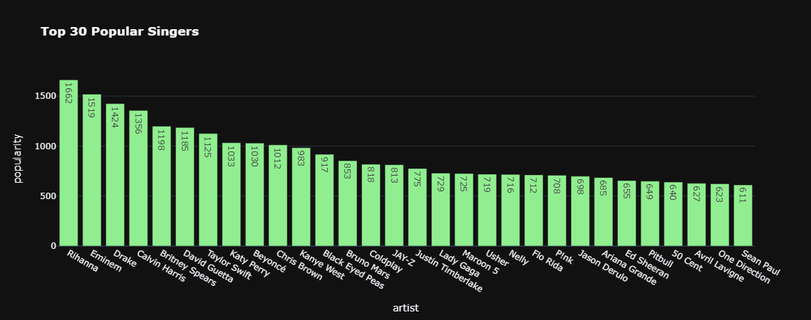
Exploratory Data Analysis
This visualization shows the ranking of the 30 most popular singers based on their popularity score. Rihanna takes the top spot with the highest popularity score of 1662, followed by Eminem and Drake. This graph shows a clear comparison between the popularity of the singers, allowing us to easily identify the most and least popular singers among the top 30 singers listed.

Slide 14
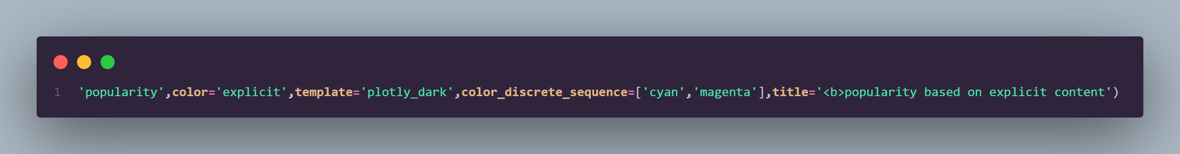
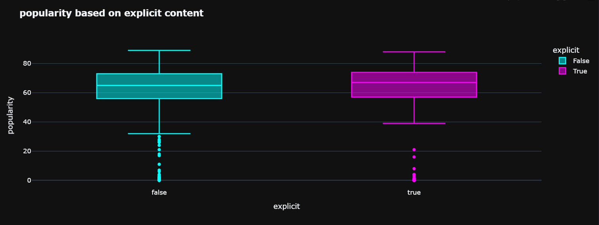
Exploratory Data Analysis
This box plot visualization shows that there is no significant difference in popularity between content that has explicit labels and that does not. Both categories, explicit and non-explicit, have almost the same popularity distribution, with a median around 60 and an interquartile range from 50 to 70. Outliers below 20 also appear in both categories, indicating that the popularity of the content is not significantly affected by the explicit label.

Slide 15
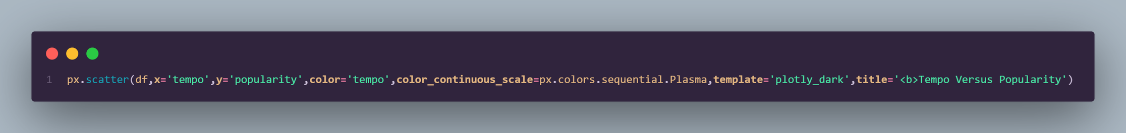
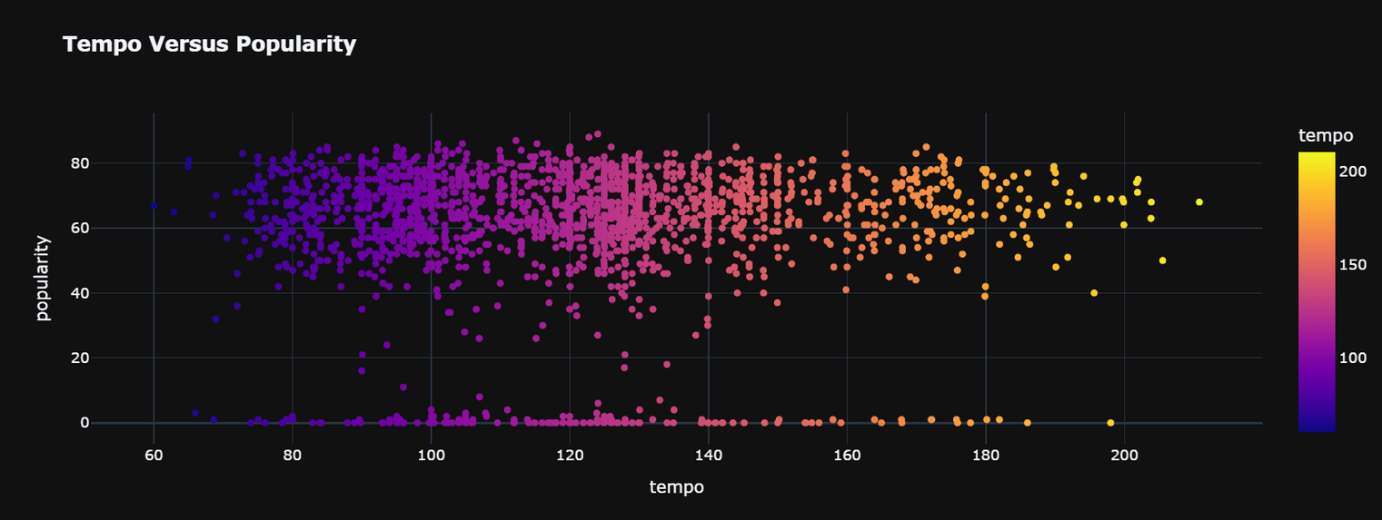
Exploratory Data Analysis
This scatter plot visualization shows the relationship between a song's tempo and its popularity. The data points are concentrated in the 80 to 160 tempo range with popularity values mostly between 40 to 80. Higher tempo songs (yellow and orange) are less frequent compared to lower tempo songs (blue and purple).

Slide 16
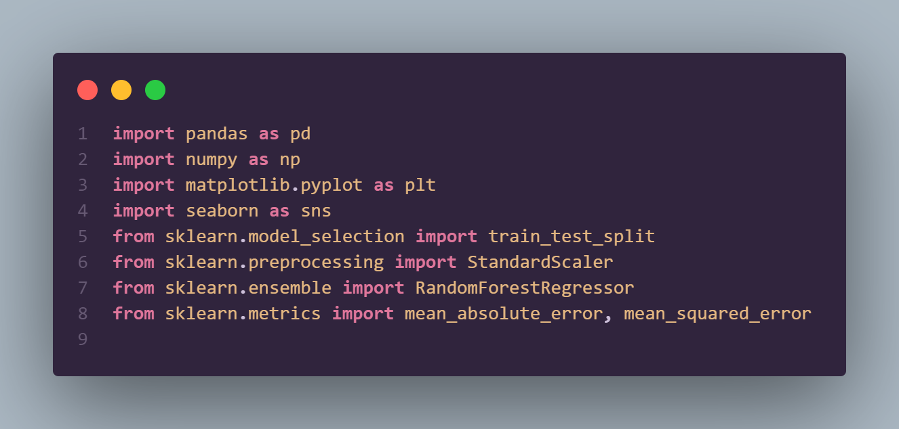
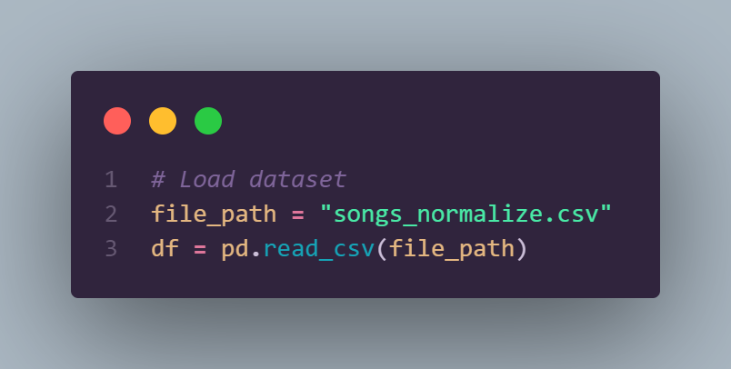
Pre-processing Data for Machine Learning

Slide 17
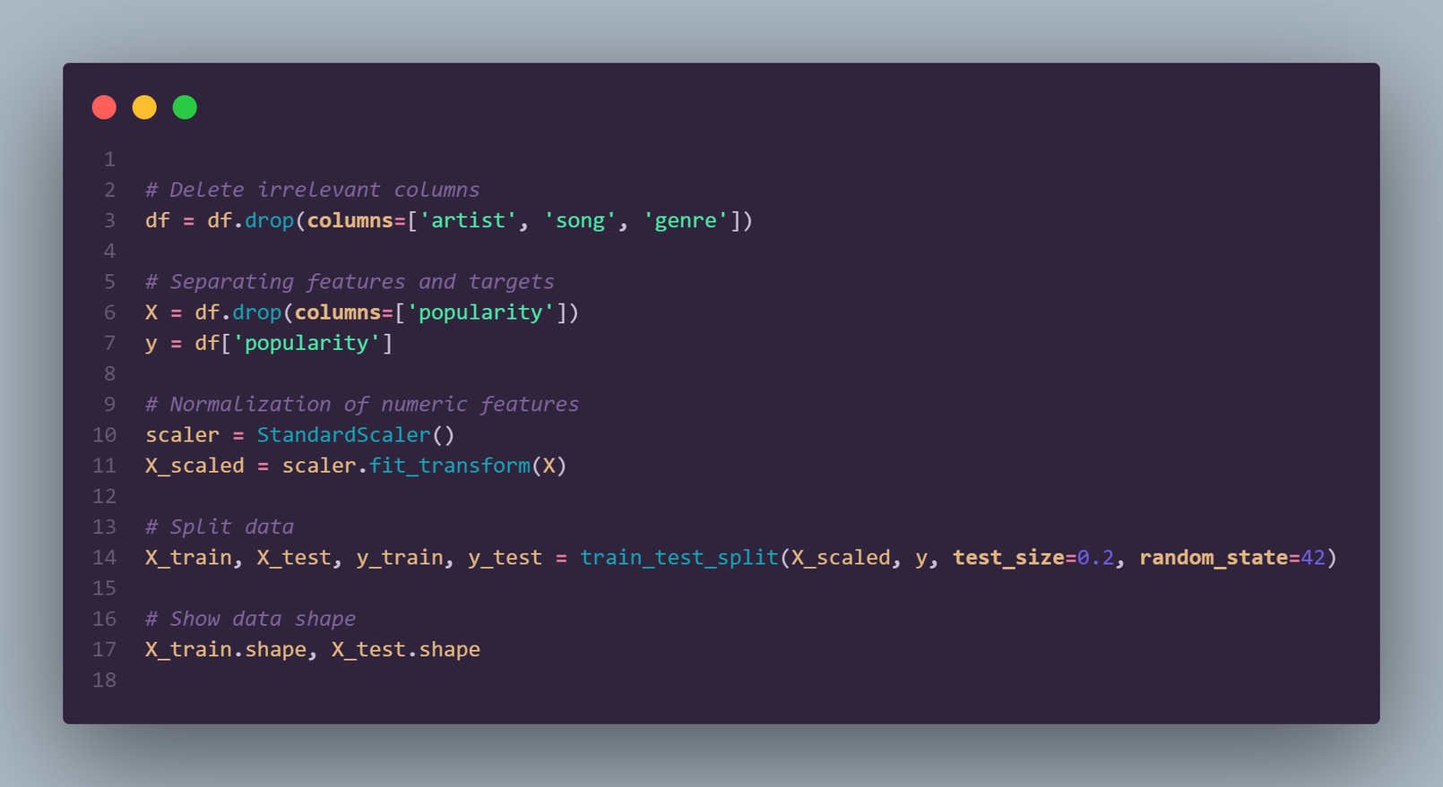
Data Modeling for Machine Learning
Removing irrelevant columns
Separating features (X) and targets (y)
Normalize numeric features
Splitting the dataset into training and testing

Slide 18
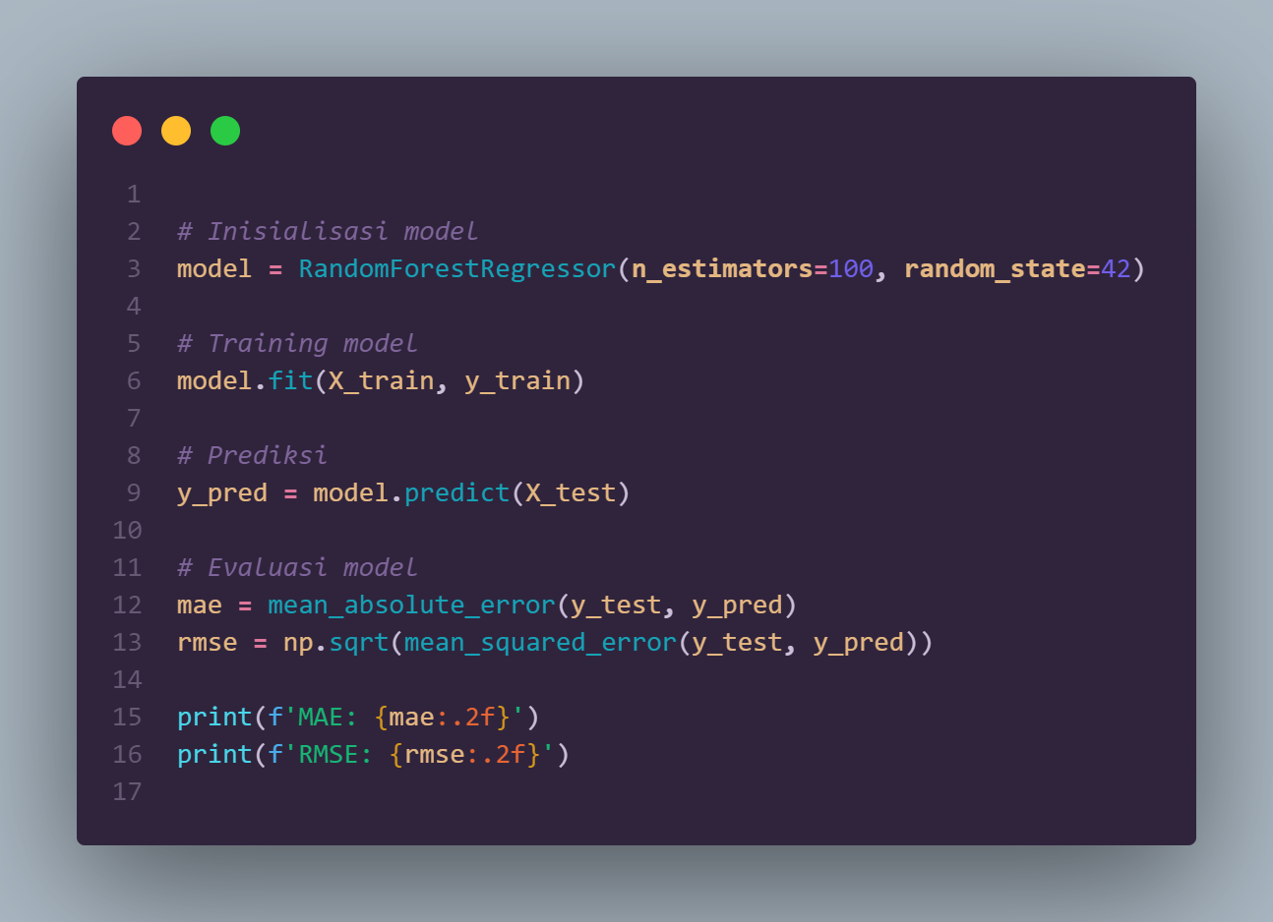
Training Model
Using Random Forest Regressor to predict song popularity.

Slide 19
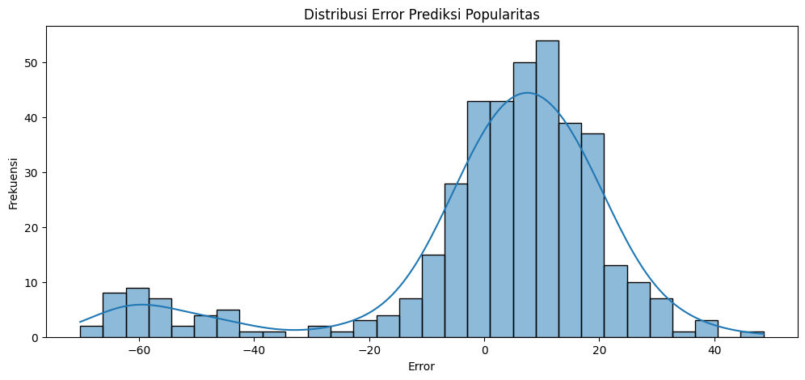
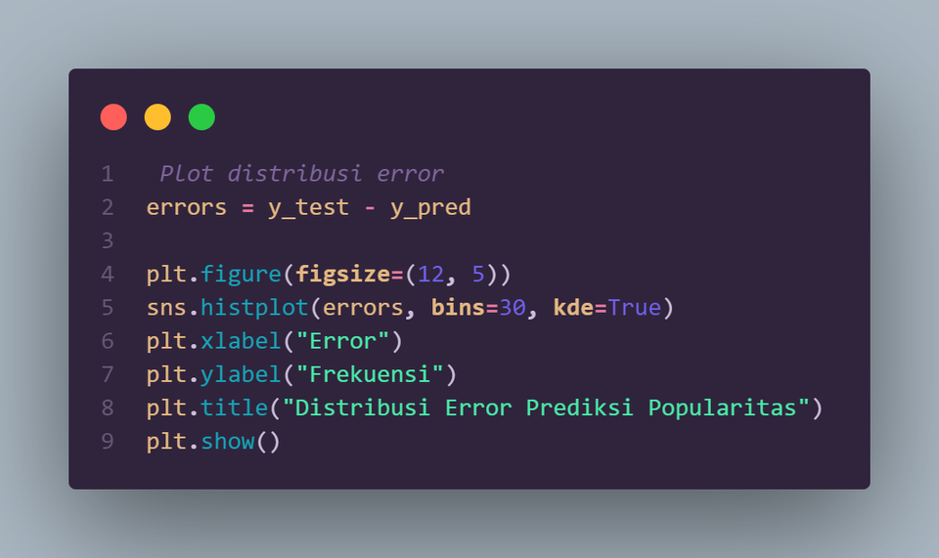
Final Visualization
This visualization shows the histogram of the popularity prediction error distribution. The majority of the prediction errors revolve around two main values, which are around -60 and 10 to 20. This may indicate the presence of two distinct groups of data or bias in the prediction model. Also, the error distribution does not appear normal, which is evident from the two peaks in the histogram. The blue line curve shows the smoothed normal distribution of the error data.

Slide 20
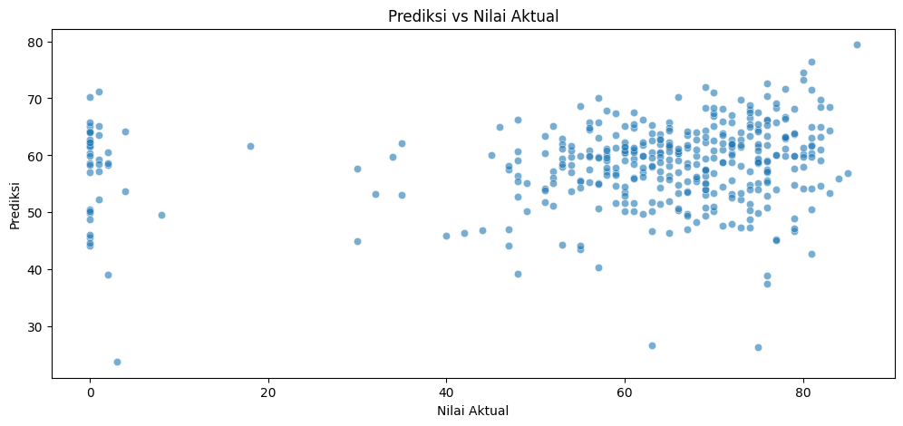
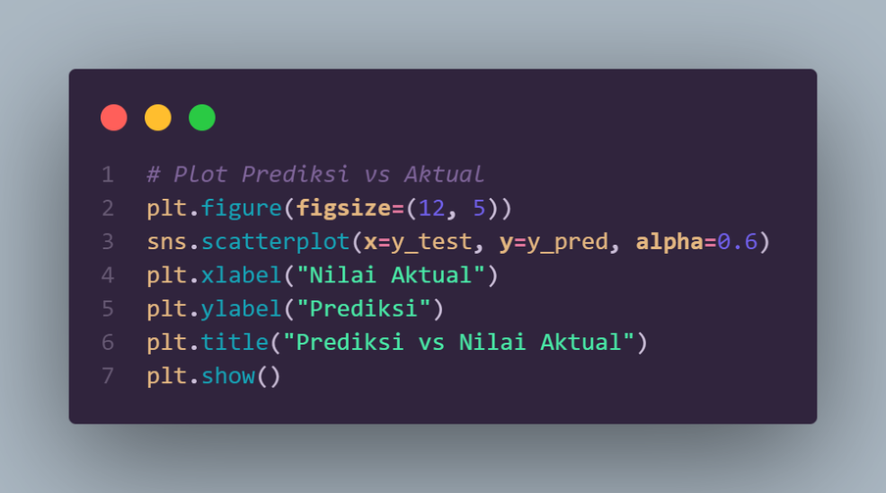
Final Visualization
The “Predicted vs Actual Values” scatter plot shows that the relationship between predicted and actual values is not completely accurate, with many data points scattered outside the ideal diagonal line. The prediction model works better in the range of actual values 60 to 80 and predictions 50 to 70.

Slide 21
In this project, we use machine learning to predict song popularity based on audio features from Spotify. The process includes data exploration, pre-processing, modeling, and visualization of results.
The results show that features such as energy and loudness have an influence on popularity. While the model is fairly accurate, external factors such as social trends and marketing also play an important role.
This study can be further developed by including additional factors to improve the prediction.
Conclusion

